Slide 1
QUALITY MANAGEMENT AND ITS PRINCIPLES
Group Members:
Muaz Zafar
Muhammad Saad
Ammar Siddiqui
Mohtada Jokhio
Muhammad Zunique

Slide 2
WHAT IS QUALITY?
DESIRED LEVEL OF EXCELLENCE IN THE PRODUCT.
FITNESS FOR USE
COMFORMANCE TO REQUIREMENT
COMFORMANCE TO SPECIFICATION

Slide 3
WHAT IS QUALITY MANAGEMENT?
IT IS AN ACT OF OVERSEEING ALL ACTIVITIES AND TASKS THAT MUST BE DONE TO ACHIEVE DESIRED DEGREE OF EXCELLENCE IN THE PRODUCT.
QUALITY MANAGEMENT SYSTEM (QMS):
QMS is defined as set of processes, procedures, documents, checklist and practices which are implemented in organization to produce and deliver products to the customer to achieve customer satisfaction. International Organization for Standardization 9001 helps organizations to develop and implement quality management system.

Slide 4
PRINCIPLES OF QUALITY MANAGEMENT
According to iso 9001 following are the principles of quality management:
Engagement of people.
Customer focus.
Leadership.
Evidence-based decision making.
Relationship management.

Slide 5
WHAT IS ENGAGEMENT OF PEOPLE?
Employee engagement describes the level of enthusiasm and dedication a worker feels toward their job. Engaged employees care about their work and about the performance of the company, and feel that their efforts make a difference.
HOW TO IMPROVE EMPLOYEE ENGAGEMENT:
Communicate with people to promote understanding of the importance of their individual contribution.
Promote collaboration throughout the organization.
Facilitate open discussion and sharing of knowledge and experience.
Recognize and acknowledge people’s contribution, learning and improvement

Slide 6
BENEFITS OF ENGAGEMENT OF PEOPLE
Enhanced involvement of people in improvement activities
Enhanced personal development, initiatives and creativity
Enhanced people satisfaction
Enhanced trust and collaboration throughout the organization

Slide 7
WHAT CUSTOMER FOCUS ?
Customer focus means exceeding customer expectations and providing satisfaction and value with every customer interaction. It requires an organization to link every business objective to customer needs and to recognize that customers are those that have both direct and indirect relationships with an organization.

Slide 8
WHY CUSTOMER FOCUS ?
Customer focus is the foundation for customer loyalty. According to the Zendesk Customer Experience Trends Report 2020, 74 percent of customers feel loyal to a particular company, with 52 percent reporting that they go out of their way to buy from their favorite brands.
What’s more, roughly half of customers say they would switch to a competitor after just one bad experience. And that number jumps to 80 percent in the case of more than one bad experience. Becoming a customer-focused organization is important for helping you ensure that customers leave the experience feeling good about your brand.

Slide 9
HOW CUSTOMER FOCUS?
Encourage collaboration
Meet your customers where they are
Use feedback to get better
Combine data with empathy
Leverage AI to proactively meet customers’ needs

Slide 10
LEADERSHIP
Leaders at all levels establish unity of purpose and direction and create conditions in which people are engaged in achieving the organization’s quality objectives.
Creation of unity of purpose and direction and engagement of people enable an organization to align its strategies, policies, processes and resources to achieve its objectives

Slide 11
BENEFITS OF LEADERSHIP
Increased effectiveness and efficiency in meeting the organization’s quality objectives
Better coordination of the organization’s processes
Improved communication between levels and functions of the organization
Development and improvement of the capability of the organization and its people to deliver desired results

Slide 12
WHAT A LEADER DOES
Communicate the organization’s mission, vision, strategy, policies and processes throughout the organization.
Create and sustain shared values, fairness and ethical models for behaviour at all levels of the organization
Establish a culture of trust and integrity
Encourage an organization-wide commitment to quality.

Slide 13
EVIDENCE BASED DECISION MAKING:
Following are some of the important points for a strong evidence based decision making.
Rely on good data
Compare the actual results to the desired results
Monitor the evidence constantly and compare the obtained results with the results of the objective.

Slide 14
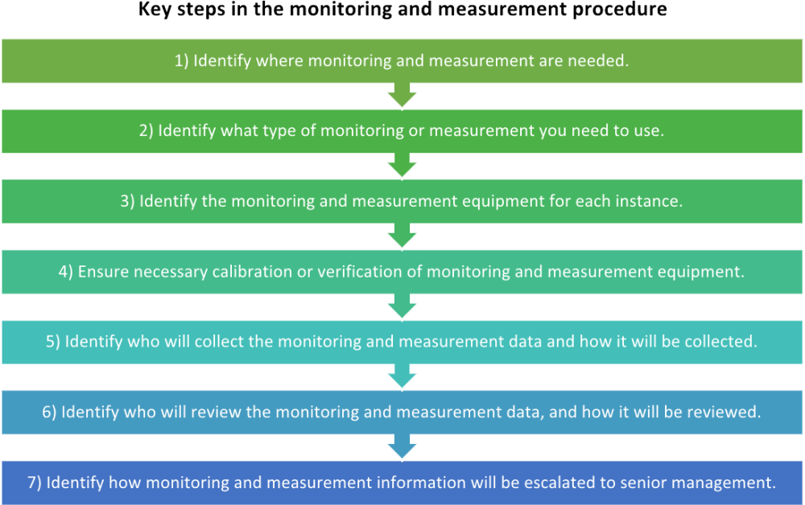
MONITORING AND MEASURING PROCEDURES

Slide 15
RELATIONSHIP MANAGEMENT
What is Relationship Management?
Relationship management is a strategy in which an organization maintains an ongoing level of engagement with its audience.
Audience:
Business to consumer (CRM)
Business to other business (BRM)
Why we need Relationship Management?
Relationship management involves strategies to build client support for a business and its offerings, and increase brand loyalty.
Consumers who feel that a company is responsive to their needs likely will continue to use that company's products and services.

Slide 16
CUSTOMER RELATIONSHIP MANAGEMENT:
All the businesses rely on CRM.
CRM involves significant amount of data to observe and understand market trends, taste of consumer.
It may also include marketing techniques and post-sale support program.
BUSINESS RELATIONSHIP
MANAGEMENT:
Relationships with vendors, suppliers, distributors, and other associates can also benefit from relationship management.
BRM seeks to build trust, solidify rules and expectations, and establish boundaries.

